Slide 1

IMPRINT User Guide
Version No. 3 – 12th of August 2026

Slide 2
Table of Contents
The Imprint User Guide is designed to be used as a step-by-step guide in creating your own survey questions. Check out the Learn more text guide on each page for more information. Contents of this guide are listed below:
Cover page
Table of Contents
Introduction
How do I Add an IMPRINT Component to a Survey?
Understanding the IMPRINT Live Editor
Understanding the Products Side Panel (Main Round)
Understanding the Products Side Panel (Practice Round)
Understanding the New Product pop-up modal
Understanding the Select Category pop-up modal
Understanding the Edit pop-up modal
How do I Add a Product in the Main Round using Single Upload option?
Understanding the Product Card
How do I Add Products in the Main Round using Multi Upload option?
How do I Remove the Image Background in the Main Round Product(s)?
How do I Crop the Image in the Main Round Product(s)?
Understanding the Select Category pop-up Modal
How do I Add a New Category in the Main Round Product(s)?
How do I Select a Category for the Main Round Product(s)?
How do I Edit / Update a Category in the Main Round Product(s)?
How do I Delete / Remove a Category in the Main Round Product(s)?
Understanding the Products More Options Dropdown Menu in the Main Round
How do I Delete a Product(s) in the Main Round?
How do I Delete all Products in the Main Round?
How do I Copy Product(s) from Main to Practice Round?
How do I Copy all Products from Main to Practice Round?

Slide 3
Table of Contents
The Imprint User Guide is designed to be used as a step-by-step guide in creating your own survey questions. Check out the Learn more text guide on each page for more information. Contents of this guide are listed below:
How do I Add Product(s) in the Practice Round using Single Upload option?
How do I Add Products in the Practice Round using Multi Upload option?
How do I Remove the Image Background in the Practice Round Product(s)?
How do I Crop the image in the Practice Round Product(s)?
How do I Add a New Category in the Practice Round Product(s)?
How do I Select a Category for the Practice Round Product(s)?
How do I Edit / Update a Category in the Practice Round Product(s)?
How do I Delete / Remove a Category in the Practice Round Product(s)?
Understanding the Products More Options Dropdown Menu in the Practice Round
How do I Delete a Product(s) in the Practice Round?
How do I Delete all Products in the Practice Round?
How do I Copy Product(s) from Practice to Main Round?
How do I Copy all Products from Practice to Main Round?
Understanding the Instructions Side Panel
Understanding the Welcome Message Instructions
Understanding the Practice Round Instructions
Understanding the Main Round Instructions
Understanding the Main Round (No Practice) Instructions
Understanding the Instructions Warning Message (Too Slow)
Understanding the Instructions Warning Message (Error Selection)
Understanding the Instructions Screenout Message
Understanding the Instructions Complete Message
Understanding the Instructions Others Message
Understanding the Editor Toolbar

Slide 4
Table of Contents
The Imprint User Guide is designed to be used as a step-by-step guide in creating your own survey questions. Check out the Learn more text guide on each page for more information. Contents of this guide are listed below:
Understanding the Button Text Editor Toolbar
How do I Add / Edit the Welcome Message?
How do I Add / Edit the Practice Round Instruction?
How do I Add / Edit the Main Round Instruction?
How do I Add / Edit the Main Round (No Practice) Instruction?
How do I Add / Edit the Warning Message (Too Slow)?
How do I Add / Edit the Warning Message (Selection Error)?
How do I Add / Edit the Screenout Message?
How do I Add / Edit the Complete Message?
Understanding the Questionnaire Side Panel
How do I Add a Question(s)?
How do I Delete a Question(s)?
How do I Delete all Questions?
Understanding the Themes Side Panel
Understanding the Theme Card
Understanding the Kebab Menu
Understanding the Save as Theme pop-up modal
How do I Save Themes?
How do I Apply Available Themes?
How do I Delete a Theme?
Understanding the Style Side Panel
Understanding the Upload Images pop-up modal
Understanding Modal Background Color Picker
Understanding Modal Background Color Picker (More Colour Options)
Understanding Modal Text Color Picker
Understanding Modal Text Color Picker (More Colour Options)
Understanding Modal Button Background Color Picker
Understanding Modal Button Background Color Picker (More Colour Options)

Slide 5
Table of Contents
The Imprint User Guide is designed to be used as a step-by-step guide in creating your own survey questions. Check out the Learn more text guide on each page for more information. Contents of this guide are listed below:
Understanding Modal Button Text Color Picker
Understanding Modal Button Text Color Picker (More Colour Options)
Understanding Shelf Front Color Picker
Understanding Shelf Front Color Picker (More Colour Options)
Understanding Shelf Top Color Picker
Understanding Shelf Top Color Picker (More Colour Options )
Understanding Shelf Shadow Color Picker
Understanding Shelf Shadow Color Picker (More Colour Options )
Understanding Shelf Text Color Picker
Understanding Shelf Text Color Picker (More Colour Options )
Understanding Post Background Color Picker
Understanding Post Background Color Picker (More Colour Options )
Understanding Post Shadow Color Picker
Understanding Post Shadow Color Picker (More Colour Options )
Understanding Price Tag Background Color Picker
Understanding Price Tag Background Color Picker (More Colour Options )
Understanding Price Tag Text Color Picker
Understanding Price Tag Text Color Picker (More Colour Options )
How do I Customise the Modal Layout?
How do I Customise the Background Style?
How do I Upload a Background Image?
How do I Customise the Shelf Style?
How do I Customise the Post Style?
Understanding the Settings Side Panel
Understanding the Search Type dropdown menu
Understanding the Setting Shortcut
Understanding the Advanced Side Panel

Slide 6
Table of Contents
The Imprint User Guide is designed to be used as a step-by-step guide in creating your own survey questions. Check out the Learn more text guide on each page for more information. Contents of this guide are listed below:
Understanding the Recent Changes Side Panel
Understanding the AI Translate pop-up modal
Understanding the Preview Side Panel
Understanding the Analysis Side Panel
How do I Use Analysis Name and Respondents ID for Analysis?
How do I Use Filters for Analysis?
Understanding the Analysis Visualization Section (Implicit)

Slide 7
Introduction
IMPRINT is a powerful market research tool that helps brands ensure their products and brand assets are easy to find in today’s crowded and competitive market.
In a world where consumers are constantly bombarded with countless options, standing out from the crowd has become more important than ever before. With IMPRINT, brands can measure the “push” type of attention their brand assets receive, ensuring that they grab the consumer’s attention and remain easily accessible. This is particularly important when it comes to finding products in a physical store or online, where consumers have limited time to make a purchase decision.
IMPRINT typically consists of the following components:
Products – Used to upload, organise, and manage product images and details for both practice and main rounds, including categorisation, display settings, and product types (target or filler).
Instructions - Used to create and customise all instructions and messages, including welcome, practice, main round, warnings, and completion messages.
Questionnaire - Used to create and manage explicit questions that can be added after the implicit test to gather additional data.
Themes – Used to save, manage, and apply predefined or custom visual styles for shelf layouts and overall test appearance.
Settings - Used to configure test parameters, including shelves, product distribution, search behaviour, timing, and inclusion or exclusion rules.
Advanced – Used to add custom CSS and JavaScript for extended design and functional customization.
Analysis – Used to review, filter, and analyse collected data, including extracted results and visual charts.
Preview – Used to view and test the survey before publishing.

Slide 8
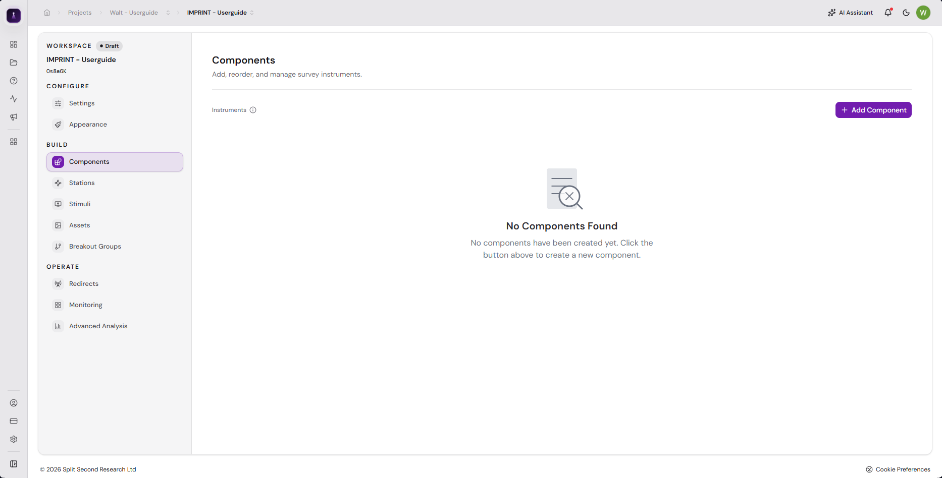
How do I add an IMPRINT component to a survey?
Table of Contents
In the Components sections of your survey, click + Add Component.
1
1

Slide 9
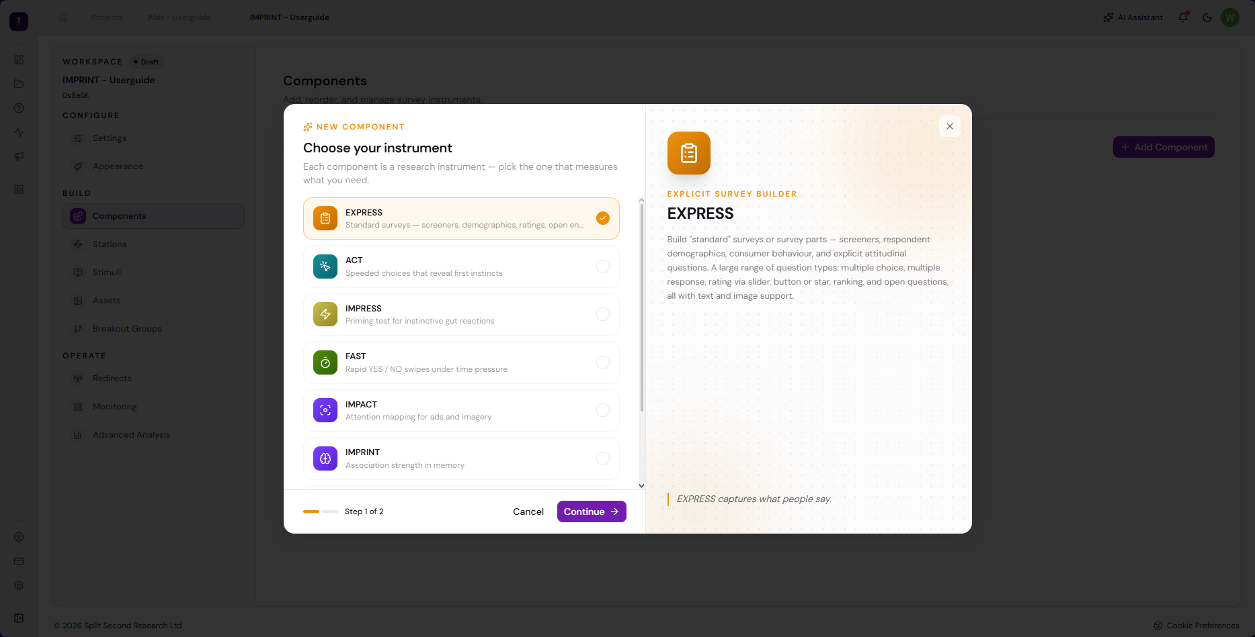
How do I add an IMPRINT component to a survey?
Table of Contents
In the Components sections of your survey, click + Add Component.
A Create Component pop-up modal will appear. Click IMPRINT.
1
2
2

Slide 10
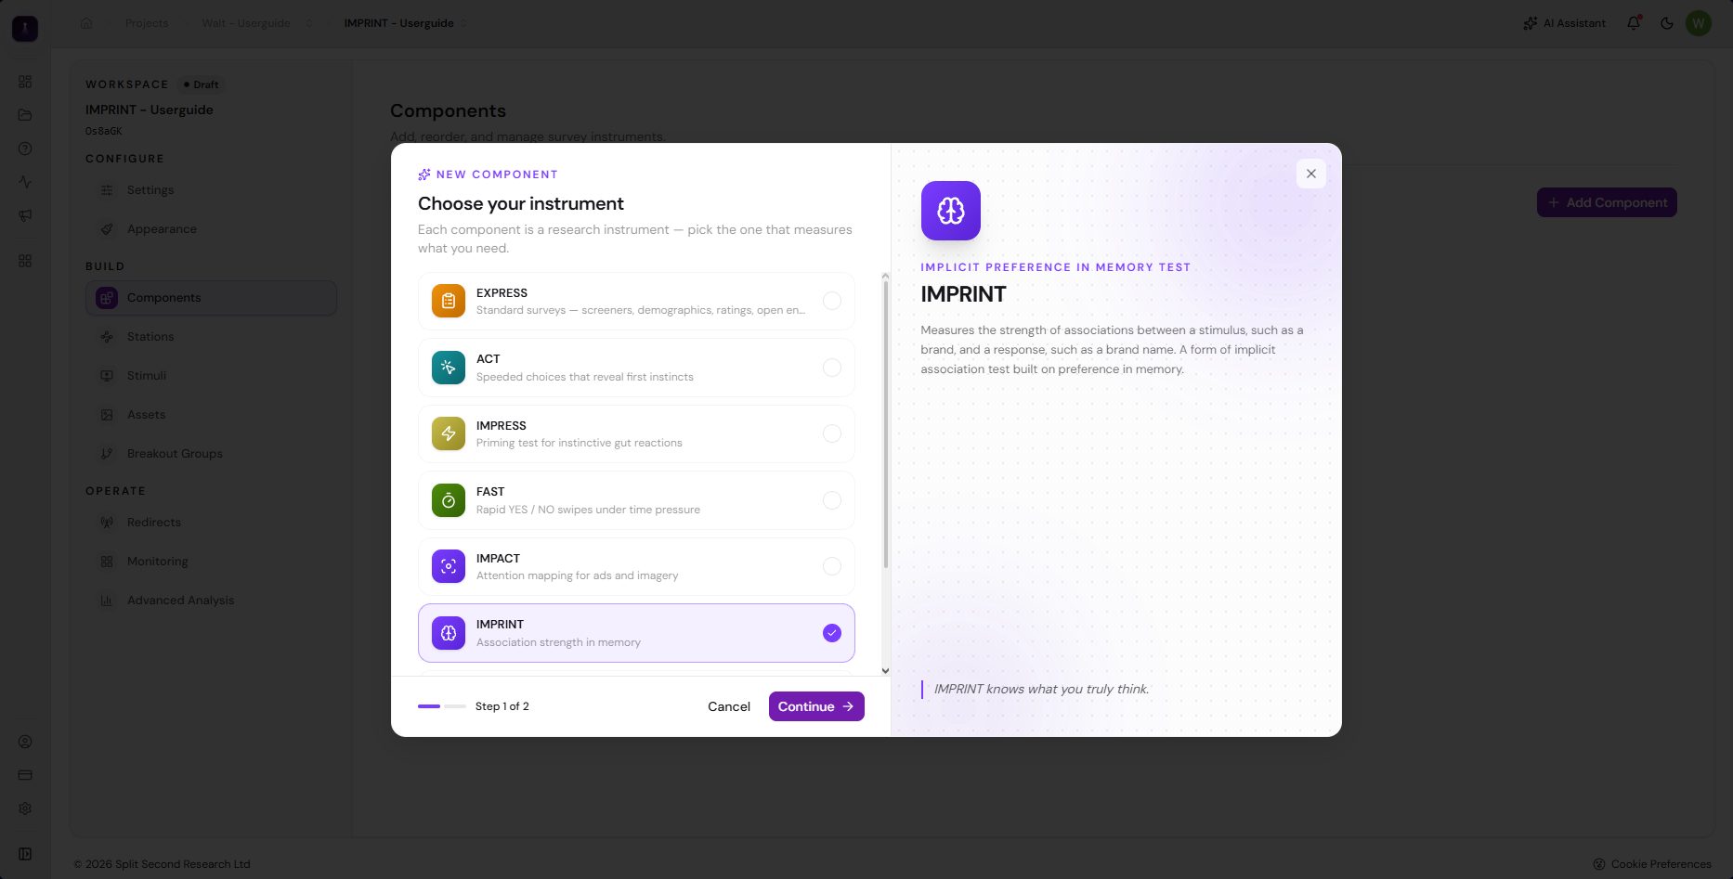
How do I add an IMPRINT component to a survey?
Table of Contents
In the Components sections of your survey, click + Add Component.
A Create Component pop-up modal will appear. Click IMPRINT.
Click Continue.
1
2
3
3

Slide 11
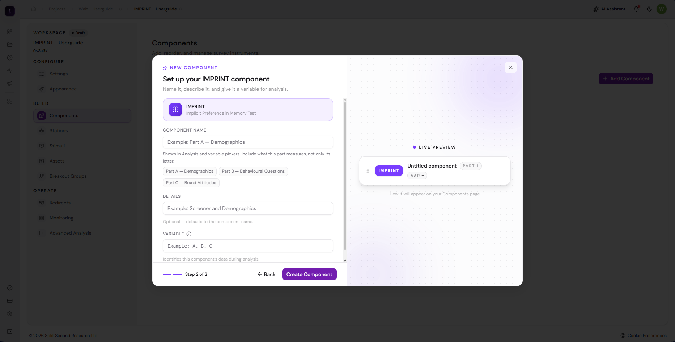
How do I add an IMPRINT component to a survey?
Table of Contents
In the Components sections of your survey, click + Add Component.
A Create Component pop-up modal will appear. Click IMPRINT.
Click Continue.
Enter the COMPONENT NAME.
Enter the Component’s DETAILS.
Enter the Component’s VARIABLE.
1
2
3
4
5
6
4
5
6

Slide 12
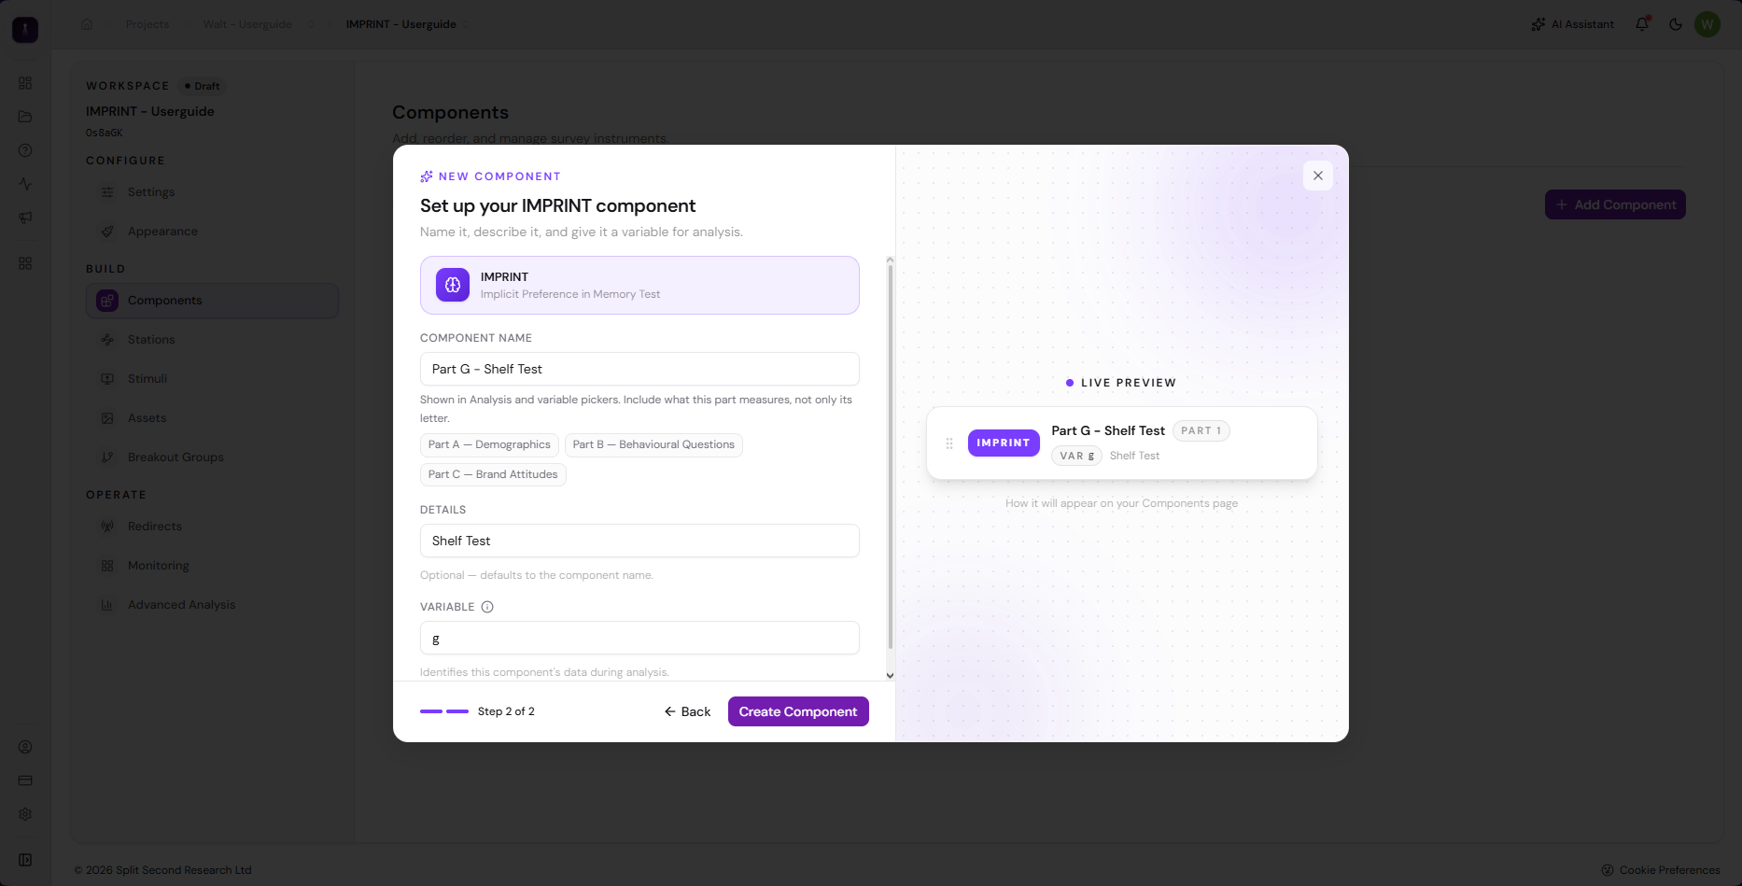
How do I add an IMPRINT component to a survey?
Table of Contents
In the Components sections of your survey, click + Add Component.
A Create Component pop-up modal will appear. Click IMPRINT.
Click Continue.
Enter the COMPONENT NAME.
Enter the Component’s DETAILS.
Enter the Component’s VARIABLE.
Click Create Components.
1
2
3
4
5
6
7
7

Slide 13
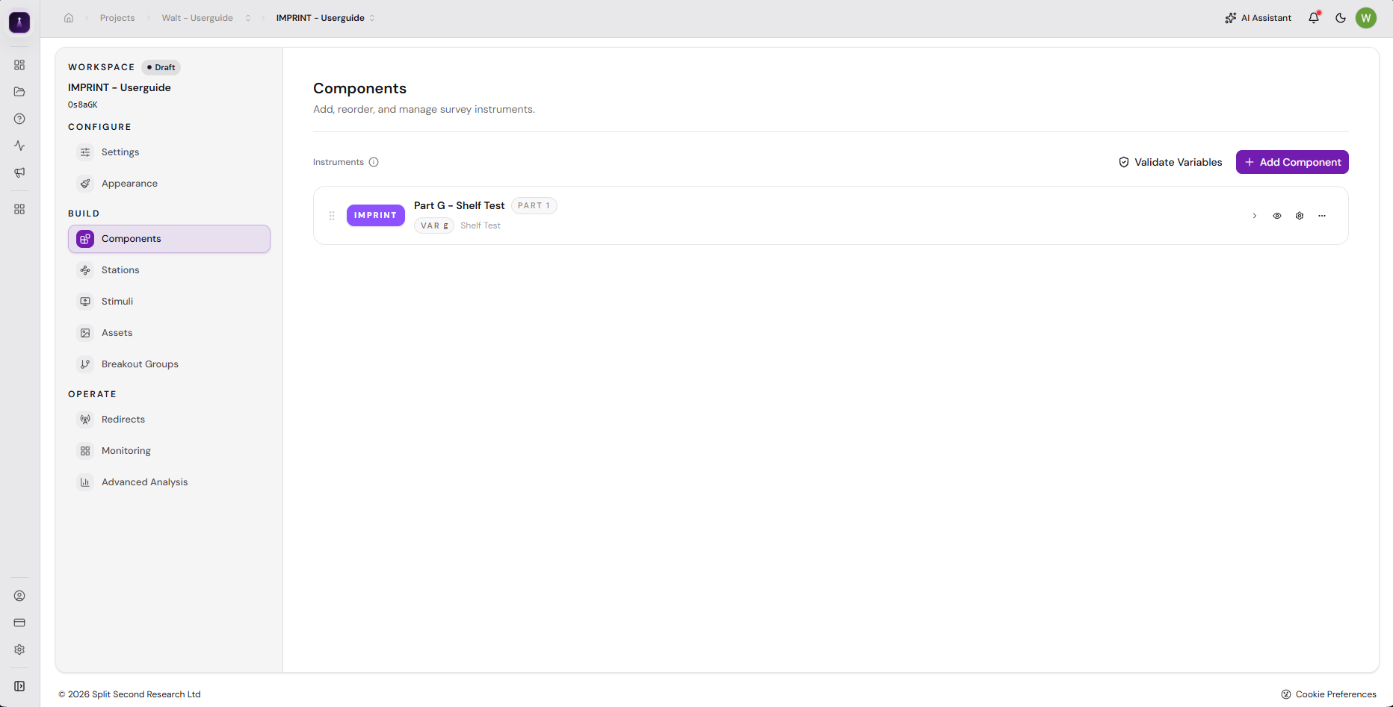
How do I add an IMPRINT component to a survey?
Table of Contents
In the Components sections of your survey, click + Add Component.
A Create Component pop-up modal will appear. Click IMPRINT.
Click Continue.
Enter the COMPONENT NAME.
Enter the Component’s DETAILS.
Enter the Component’s VARIABLE.
Click Create Components.
The created Imprint Component will now be added in the Components section. Select this to open the Imprint Component and start building the survey.
1
2
3
4
8
5
6
7
8

Slide 14
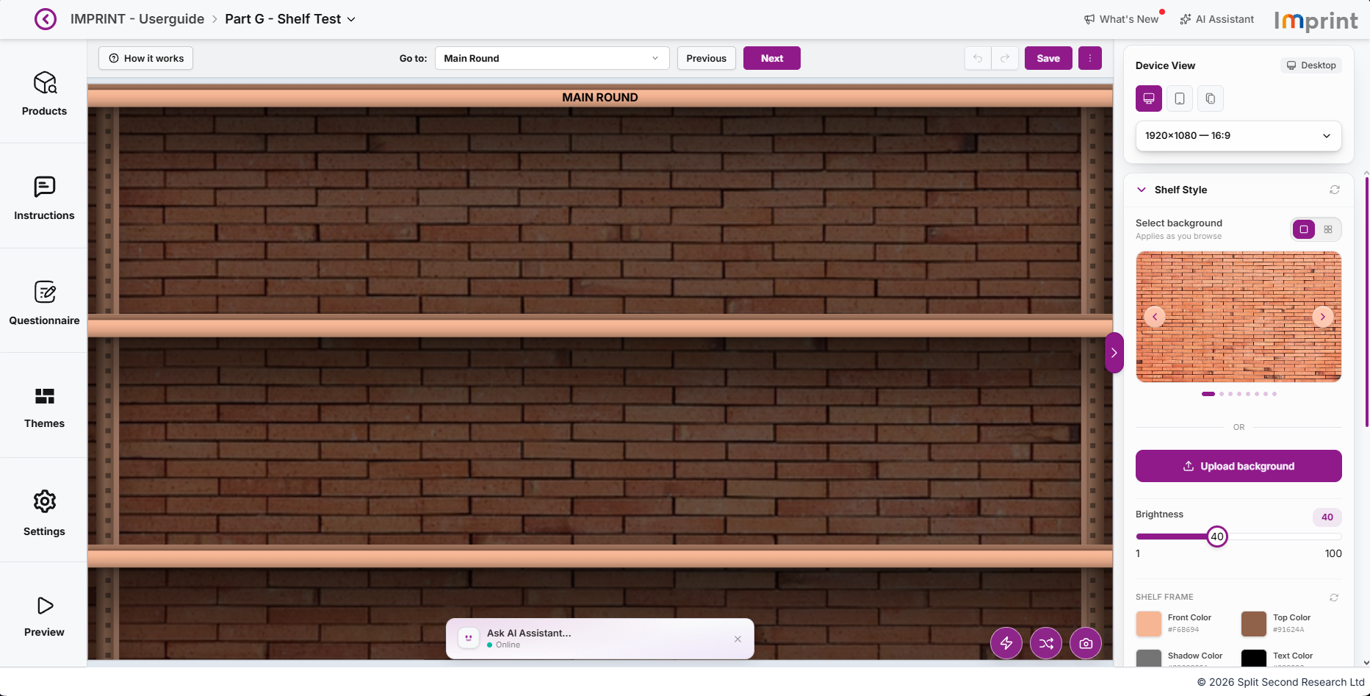
Understanding the IMPRINT live editor
Table of Contents
21
20
19
18
14
13
Products – Used to upload and manage product packaging or brand items. This section allows you to add, edit, and organise the products that will appear in your shelf test. Learn more
Instructions – Used to set up and customise the messages shown to respondents throughout the test. All instructions, prompts, and system messages can be edited here. You can also manage the survey flow, such as enabling or disabling rounds. Learn more
Questionnaire – Used to add and manage questions for the explicit round of your survey, enabling you to gather additional feedback from respondents after the implicit round. Learn more
Themes – Used to browse, apply, and manage saved theme presets for shelf test designs, allowing for quick visual customisation. Learn more
Settings – Used to customise test parameters and preferences, such as shelf configuration, behaviour, and rules. Learn more
1
1
16
2
2
17
15
3
12
4
3
11
5
4
6
7
8
10
5
9

Slide 15
Understanding the IMPRINT live editor
Table of Contents
21
20
19
18
14
13
Preview – Used to view your shelf test in draft or live mode, allowing you to review the survey before deployment. Learn more
AI Assistant Chat Box – Opens the AI chat box, which can help you modify the product display, configure settings, and add explicit questions. Learn more
Settings Quick Access – Used to quickly access some of the settings options. Learn more
Shuffle button – Used to shuffle self products.
Screenshot button – Used to take a screenshot of the shelf.
Style Panel – Used to adjust the visual appearance of your shelf test, including the modal layout, background, shelf, post, price tag, and colours. Learn more
Chevron icon - Used to expand or collapse the Style side panel.
AI Assistant – Used this to open the AI Assistant Chat Box. Learn more
What’s New – Displays the latest changes, updates, and improvements to the IMPRINT platform. Learn more
6
1
7
16
2
17
15
8
3
12
9
4
11
10
5
11
6
12
7
8
10
13
9
14

Slide 16
Understanding the IMPRINT live editor
Table of Contents
21
20
19
18
14
13
Kebab Menu – Provides access to additional actions and options for managing your project, including saving, previewing, and reviewing, restoring, or reverting recent changes. Learn more
Save – Used to save the changes made.
Undo / Redo – Used to undo or redo changes made to the survey.
Next – Used to navigate to the next page or section.
Previous – Used to navigate to the previous page or section.
Navigation Dropdown – Used to navigate between different pages or sections of the shelf test. .
How it works – Used to launch a guided tour of the Imprint live editor. The Imprint User Guide can also be downloaded here.
15
1
16
16
2
17
15
17
3
18
12
19
4
11
20
5
21
6
7
8
10
9

Slide 17
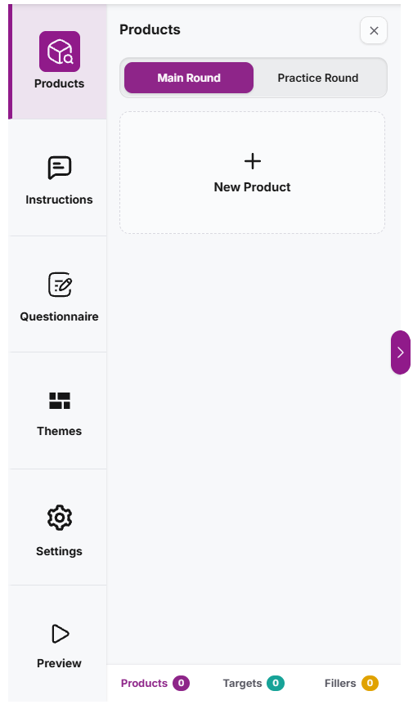
Understanding the Products Side Panel (Main Round)
Table of Contents
Main Round – This section allows you to manage test items and product details for the Main Round.
+ New Product – This allows you to add new product/s to your Main Round.
Total Count – Displays the total number of products in the Main Round, including how many belong to the Target group and how many are Filler products. These counts also act as filters. Learn more
Chevron Icon – Allows you to expand the Products side panel.
Close (X) icon – Allows you to close the Products side panel.
5
1
1
2
2
3
4
4
5
3

Slide 18
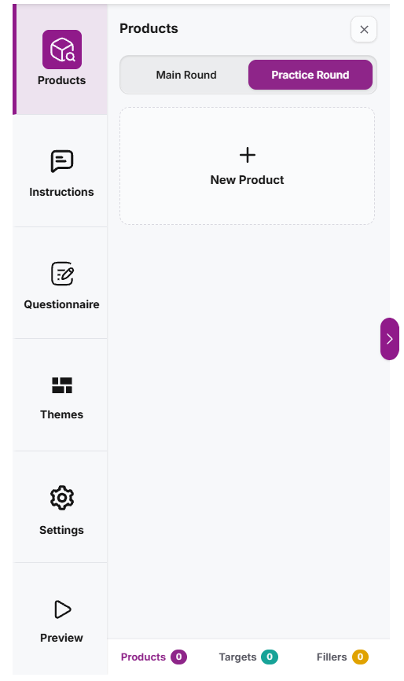
Understanding the Products Side Panel (Practice Round)
Table of Contents
Practice Round – This section allows you to manage test items and product details for the Practice Round.
+ New Product – This allows you to add new product/s to your Practice Round.
Total Count – Displays the total number of products in the Practice Round, including how many belong to the Target group and how many are Filler products. These counts also act as filters. Learn more
Chevron Icon – Allows you to expand the Products side panel.
Close (X) icon – Allows you to close the Products side panel.
5
1
1
2
2
3
4
4
5
3

Slide 19
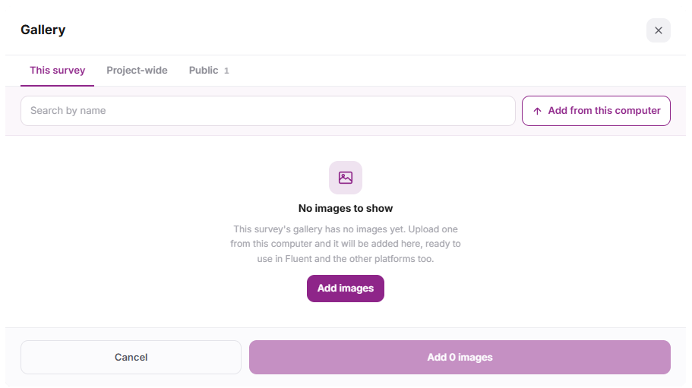
Understanding the Gallery pop-up modal
Table of Contents
This survey – Displays images that are available only within the current survey. These images cannot be accessed or used in other surveys.
Project-wide – Displays images that can be accessed and used across the project.
Public – Displays images that are publicly available and can be accessed and used by anyone.
Search bar – Available in every tab and allows you to search for images by entering the image name.
Add from this computer – Allows you to add images from your computer.
Add images – Appears when there are no images in the selected tab and allows you to add images from your computer.
Add 0 images – Adds the selected images to the component. The number(0) automatically updates based on the number of images selected.
Cancel button – Closes the Gallery pop-up modal and cancels the image selection.
1
1
2
3
9
2
4
5
3
4
5
6
6
7
8
7
8

Slide 20
Understanding the Gallery pop-up modal
Table of Contents
Close (X) icon – Closes the Gallery pop-up modal.
9
1
2
3
9
4
5
6
8
7

Slide 21
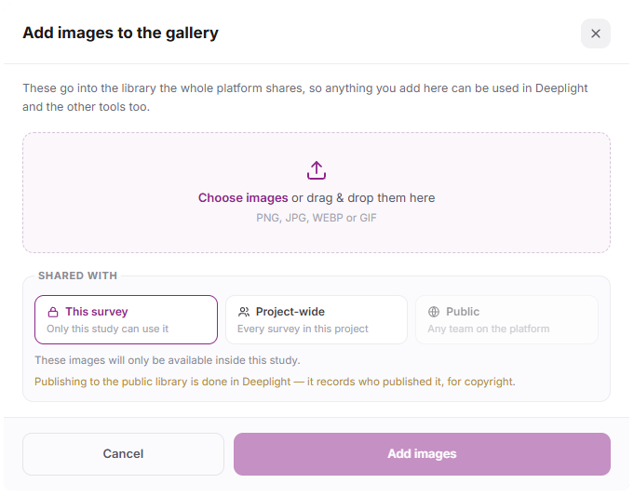
Understanding the Add images to the gallery pop-up modal
Table of Contents
Upload Image Area – Allows you to drag and drop images or click the area to browse and select images from your computer.
This Survey – Uploads images that will only be available within the current survey.
Project-wide – Uploads images that will be available across the project.
Public – Uploads images that will be publicly available. Public images are uploaded through Deeplight.
Add Images button – Adds the selected images to the gallery.
Cancel button – Closes the Add Images to the Gallery pop-up modal and cancels the image upload.
Close (X) icon – Closes the Add Images to the Gallery pop-up modal.
1
7
2
3
1
4
5
6
2
3
4
7
6
5

Slide 22
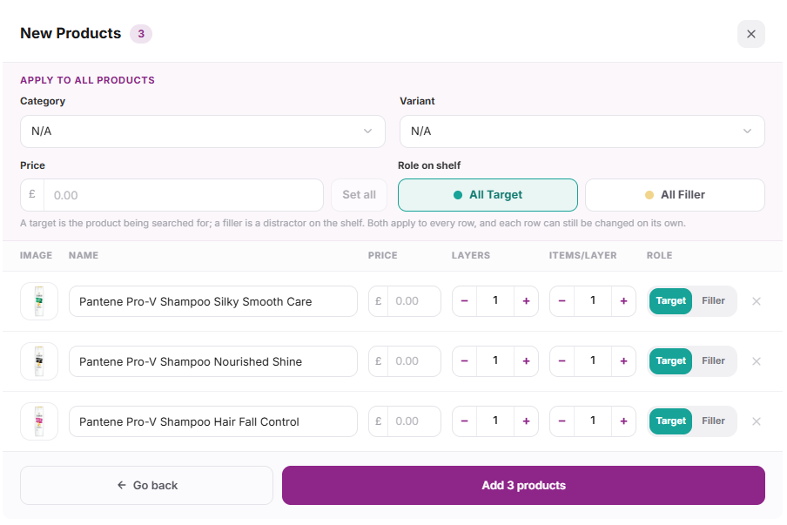
Understanding the New Products pop-up modal
Table of Contents
Category – Used to assign a category to the products. This applies to all products below. Learn more
Variant – Used to assign a variant to the products. This applies to all products below. Learn more
Price Tag – Used to add or define the price of the products.
Set All – Used to apply the specified price tag to all products below.
All Target – Marks all products as Target products that respondents will be asked to search for.
All Filler – Marks all products as Filler products that are display-only and not included in search tasks.
Product Image – This column displays the images of the selected products.
Product Name – This column displays the names of the selected products. By default, the product name is automatically set to the image file name and can be edited as needed.
Price Tag – This column is used to add or define the price of each product.
16
1
4
5
2
1
2
3
6
3
4
7
13
5
8
9
10
11
12
6
15
14
7
8
9

Slide 23
Understanding the New Products pop-up modal
Table of Contents
Layers – This column is used to define the number of layers for the product display.
Items per Layer – This column is used to define how many items are displayed in each layer.
Role on Shelf – This column allows you to modify the role of each product individually. You can set each product as a Target or Filler depending on its role on the shelf.
Delete (X) button – This column displays an X button for each product in the last column, allowing you to delete or remove the product.
Add products – Adds the selected products to the Main / Practice Round.
Go back – Allows you to return to the previous page in the Gallery.
Close (X) icon – Closes the New Products pop-up modal.
16
10
4
5
11
1
2
3
6
12
7
13
13
8
9
10
11
12
14
15
14
15
16

Slide 24
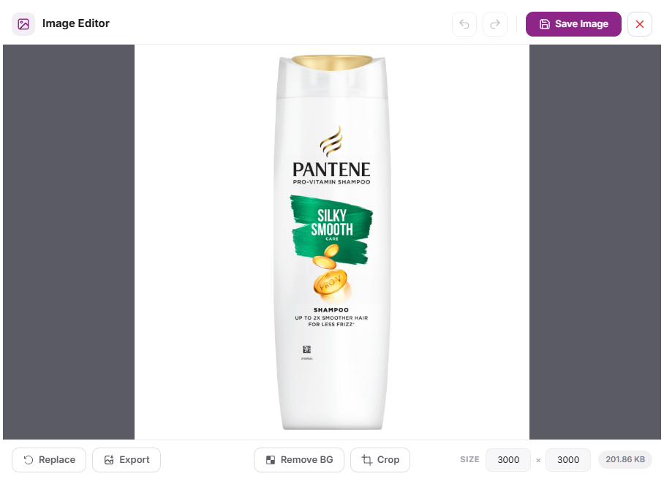
Understanding the Edit pop-up modal
Table of Contents
1
2
3
Undo / Redo button – Allows you to undo or redo changes made to the image.
Save Image – Saves the changes applied to the image.
Close (X) icon – Closes the Edit pop-up modal without saving any changes made.
Size – Allows you to adjust the image size.
Crop – Allows you to crop the image. Learn more
Remove BG – Allows you to remove the image background. Learn more
Export Image – Allows you to export the image to your device or local storage.
Replace Image – Allows you to replace the current image with a new one.
1
2
3
4
5
6
7
8
8
7
6
5
4

Slide 25
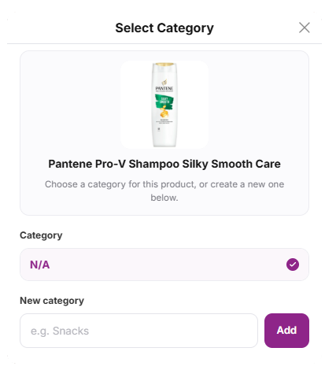
Understanding the Select Category pop-up modal
Table of Contents
Drag Area – Allows you to move the Select Category pop-up modal by dragging it.
Close (X) icon – Allows you to close the Select Category pop-up modal.
Product Details – Displays the product image and name.
Category – N/A is the default category. Any added categories are displayed below it.
New Category – A text box used to enter a new category.
Add – Adds the new category entered in the text box.
1
1
2
2
3
4
3
5
6
4
5
6

Slide 26
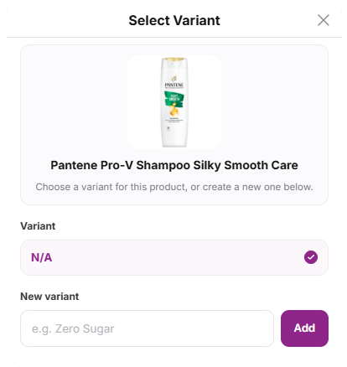
Understanding the Select Variant pop-up modal
Table of Contents
Drag Area – Allows you to move the Select Variant pop-up modal by dragging it.
Close (X) icon – Allows you to close the Select Variant pop-up modal.
Product Details – Displays the product image and name.
Category – N/A is the default variant. Any added categories are displayed below it.
New Category – A text box used to enter a new variant.
Add – Adds the new variant entered in the text box.
1
1
2
2
3
3
4
5
6
4
5
6

Slide 27
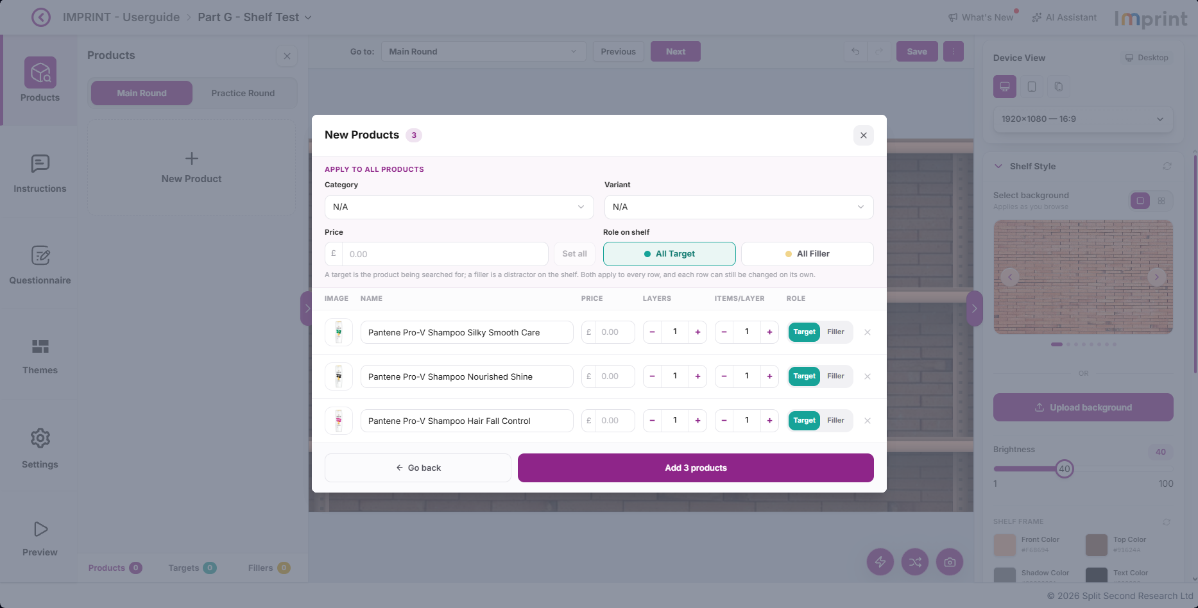
How do I Add a New Category?
Table of Contents
In the New Products pop-up modal, click the Category dropdown menu.
1
1

Slide 28
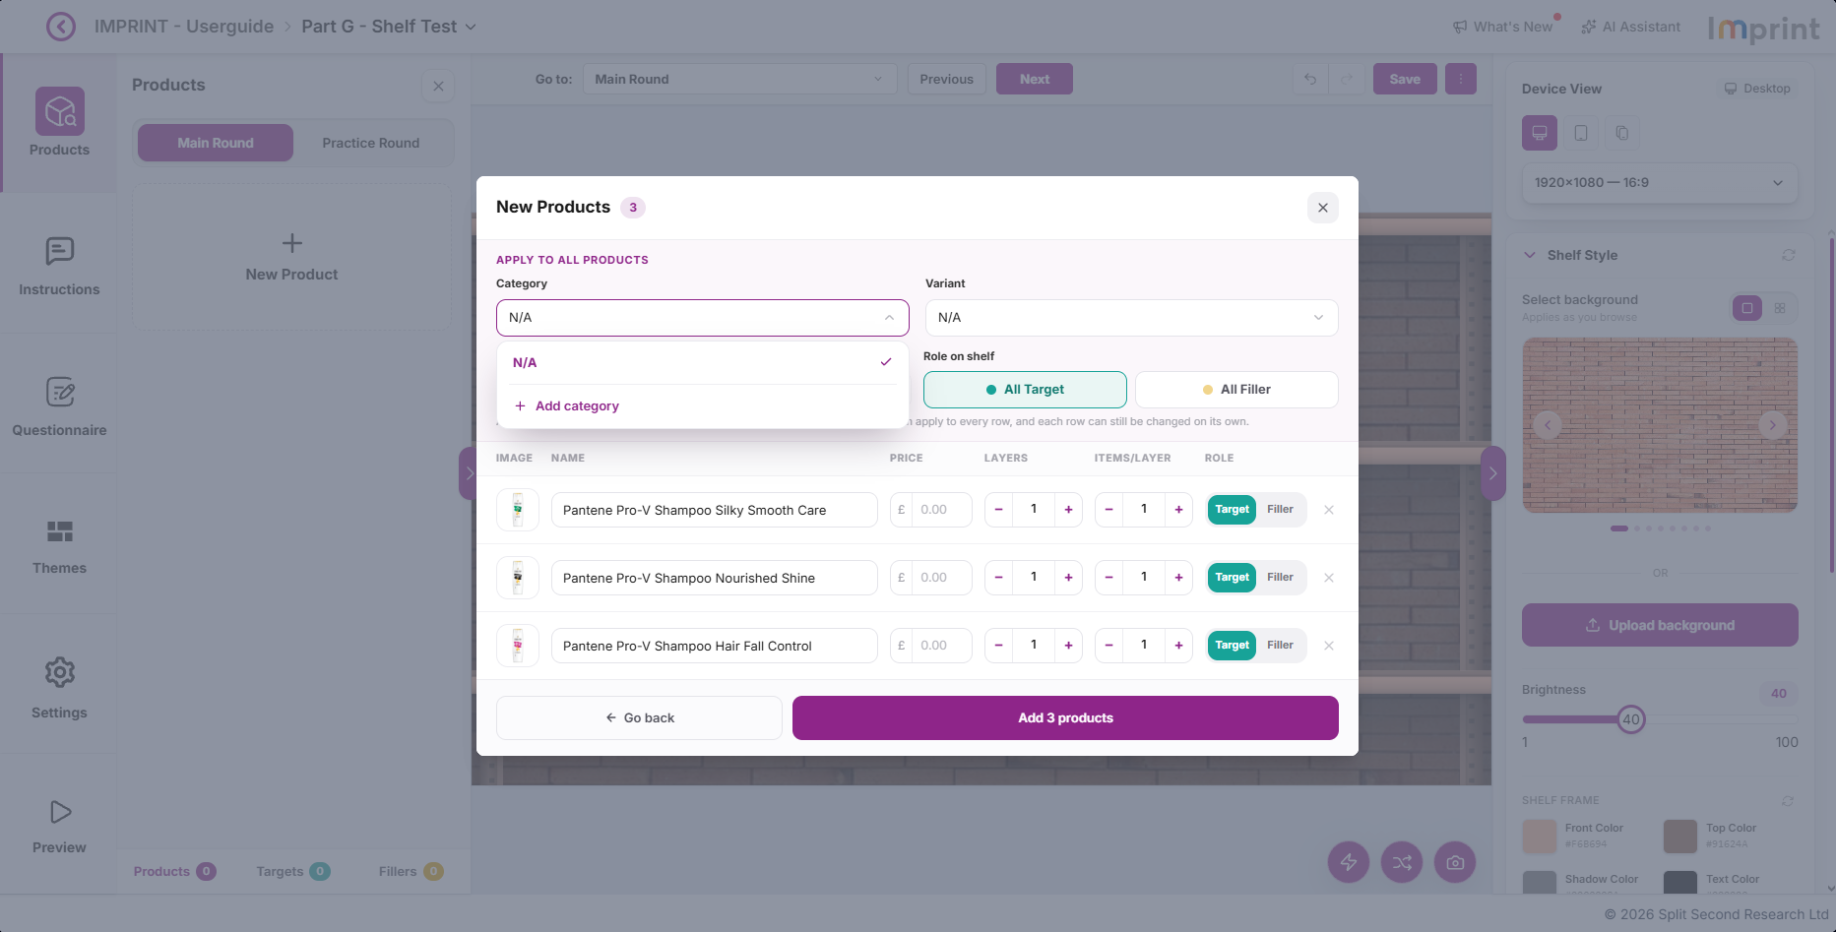
How do I Add a New Category?
Table of Contents
In the New Products pop-up modal, click the Category dropdown menu.
Click + Add Category at the bottom of the dropdown menu to add a new category.
1
2
2

Slide 29
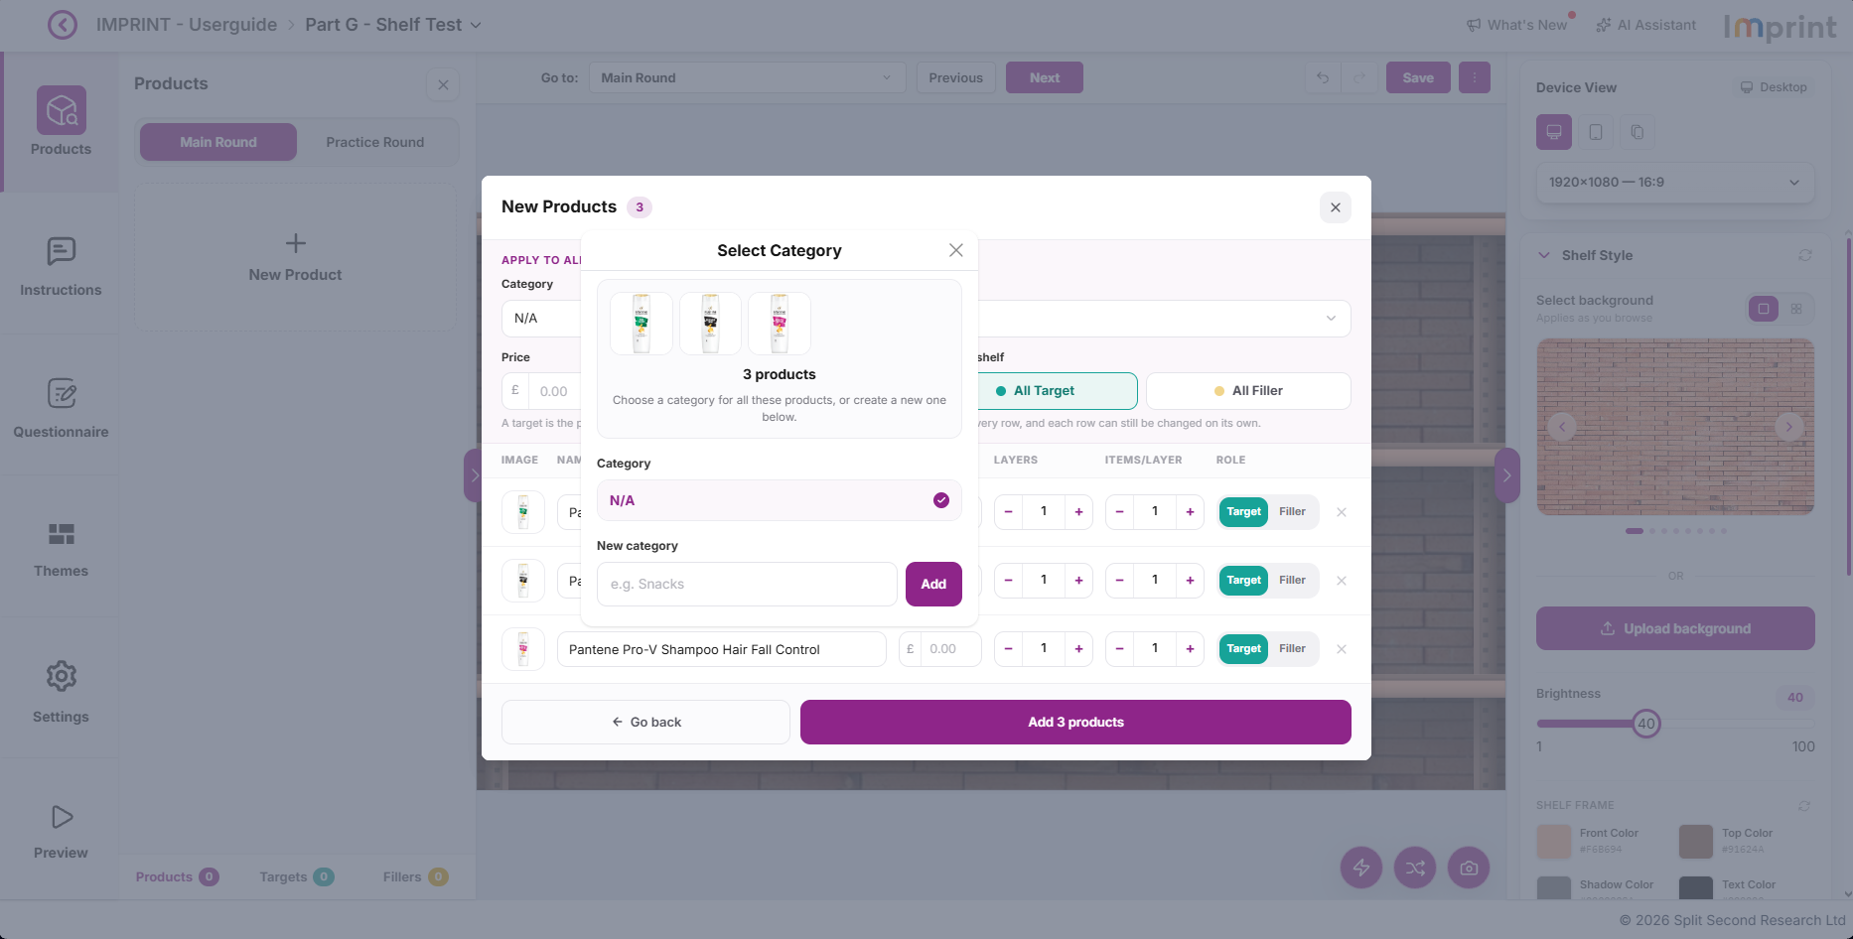
How do I Add a New Category?
Table of Contents
In the New Products pop-up modal, click the Category dropdown menu.
Click + Add Category at the bottom of the dropdown menu to add a new category.
The Select Category pop-up modal will appear. Enter the New Category you want to add.
1
2
3
3

Slide 30

How do I Add a New Category?
Table of Contents
In the New Products pop-up modal, click the Category dropdown menu.
Click + Add Category at the bottom of the dropdown menu to add a new category.
The Select Category pop-up modal will appear. Enter the New Category you want to add.
Click Add to add the new category.
1
2
3
4
4

Slide 31
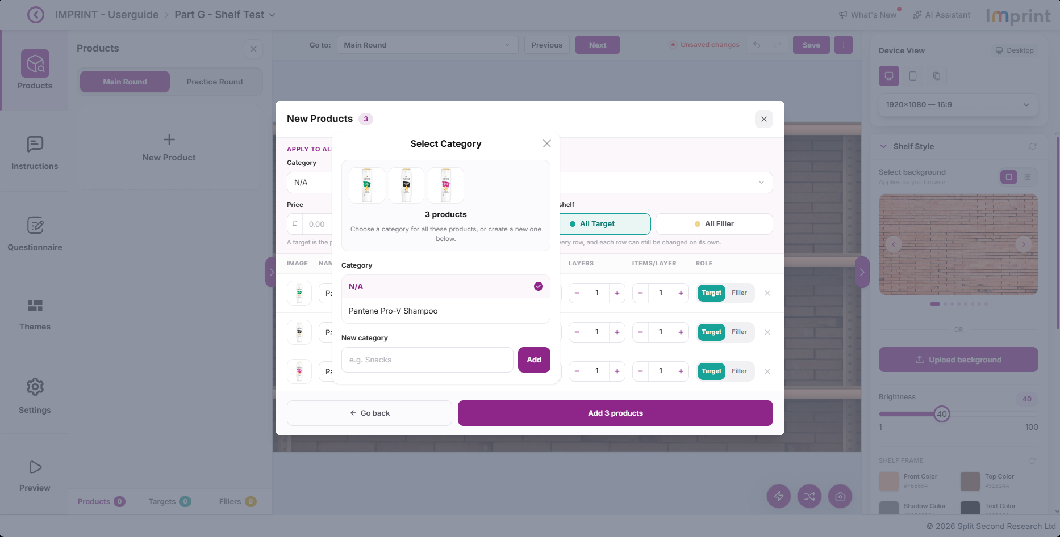
How do I Add a New Category?
Table of Contents
In the New Products pop-up modal, click the Category dropdown menu.
Click + Add Category at the bottom of the dropdown menu to add a new category.
The Select Category pop-up modal will appear. Enter the New Category you want to add.
Click Add to add the new category.
The New Category will appear below N/A. Repeat Steps 3 to 4 to add additional categories.
1
2
3
4
5
5

Slide 32

How do I Select a Category?
Table of Contents
In the New Products pop-up modal, click the Category dropdown menu.
1
1

Slide 33

How do I Select a Category?
Table of Contents
In the New Products pop-up modal, click the Category dropdown menu.
Select the Category you want to assign to your products.
1
2
2

Slide 34

How do I Select a Category?
Table of Contents
In the New Products pop-up modal, click the Category dropdown menu.
Select the Category you want to assign to your products.
The selected Category will now be applied to all products below.
1
2
3
3

Slide 35

How do I Edit a Category?
Table of Contents
1
Click the Category field.
1

Slide 36

How do I Edit a Category?
Table of Contents
1
Click the Category field.
The Category dropdown menu will appear. Scroll down and click + Add category.
2
2

Slide 37
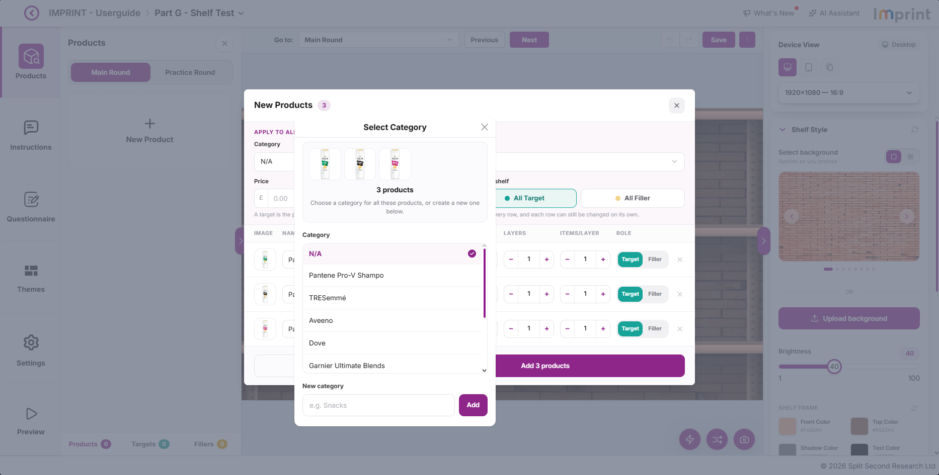
How do I Edit a Category?
Table of Contents
1
Click the Category field.
The Category dropdown menu will appear. Scroll down and click + Add category.
The Select Category pop-up modal will appear. Hover over the category you want to edit.
2
3
3

Slide 38

How do I Edit a Category?
Table of Contents
1
Click the Category field.
The Category dropdown menu will appear. Scroll down and click + Add category.
The Select Category pop-up modal will appear. Hover over the category you want to edit.
Two options will appear: Edit and Delete. Click the Edit icon.
2
3
4
4

Slide 39

How do I Edit a Category?
Table of Contents
1
Click the Category field.
The Category dropdown menu will appear. Scroll down and click + Add category.
The Select Category pop-up modal will appear. Hover over the category you want to edit.
Two options will appear: Edit and Delete. Click the Edit icon.
The category name will become editable. Enter the updated Category.
2
3
4
5
5

Slide 40

How do I Edit a Category?
Table of Contents
1
Click the Category field.
The Category dropdown menu will appear. Scroll down and click + Add category.
The Select Category pop-up modal will appear. Hover over the category you want to edit.
Two options will appear: Edit and Delete. Click the Edit icon.
The category name will become editable. Enter the updated Category.
Click the Check icon to save your changes. The category will be updated.
2
3
4
5
6
6

Slide 41

How do I Delete / Remove a Category?
Table of Contents
1
Click the Category field.
1

Slide 42

How do I Delete / Remove a Category?
Table of Contents
1
Click the Category field.
The Category dropdown menu will appear. Scroll down and click + Add category.
2
2

Slide 43

How do I Delete / Remove a Category?
Table of Contents
1
Click the Category field.
The Category dropdown menu will appear. Scroll down and click + Add category.
The Select Category pop-up modal will appear. Hover over the category you want to delete.
2
3
3

Slide 44

How do I Delete / Remove a Category?
Table of Contents
1
Click the Category field.
The Category dropdown menu will appear. Scroll down and click + Add category.
The Select Category pop-up modal will appear. Hover over the category you want to delete.
Two options will appear: Edit and Delete. Click the Delete icon.
2
3
4
4

Slide 45
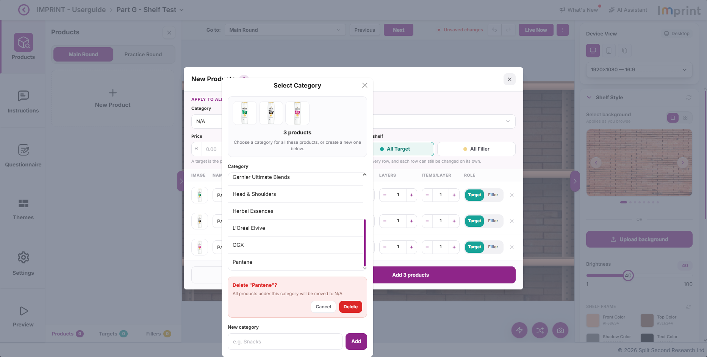
How do I Delete / Remove a Category?
Table of Contents
1
Click the Category field.
The Category dropdown menu will appear. Scroll down and click + Add category.
The Select Category pop-up modal will appear. Hover over the category you want to delete.
Two options will appear: Edit and Delete. Click the Delete icon.
A confirmation message will appear. Click Delete to delete / remove the category.
2
3
4
5
5

Slide 46

How do I Add a New Variant?
Table of Contents
In the New Products pop-up modal, click the Variant dropdown menu.
1
1

Slide 47

How do I Add a New Variant?
Table of Contents
In the New Products pop-up modal, click the Variant dropdown menu.
Click + Add Variant at the bottom of the dropdown menu to add a new variant.
1
2
2

Slide 48

How do I Add a New Variant?
Table of Contents
In the New Products pop-up modal, click the Variant dropdown menu.
Click + Add Variant at the bottom of the dropdown menu to add a new variant.
The Select Variant pop-up modal will appear. Enter the New Variant you want to add.
1
2
3
3

Slide 49

How do I Add a New Variant?
Table of Contents
In the New Products pop-up modal, click the Variant dropdown menu.
Click + Add Variant at the bottom of the dropdown menu to add a new variant.
The Select Variant pop-up modal will appear. Enter the New Variant you want to add.
Click Add to add the new category.
1
2
3
4
4

Slide 50
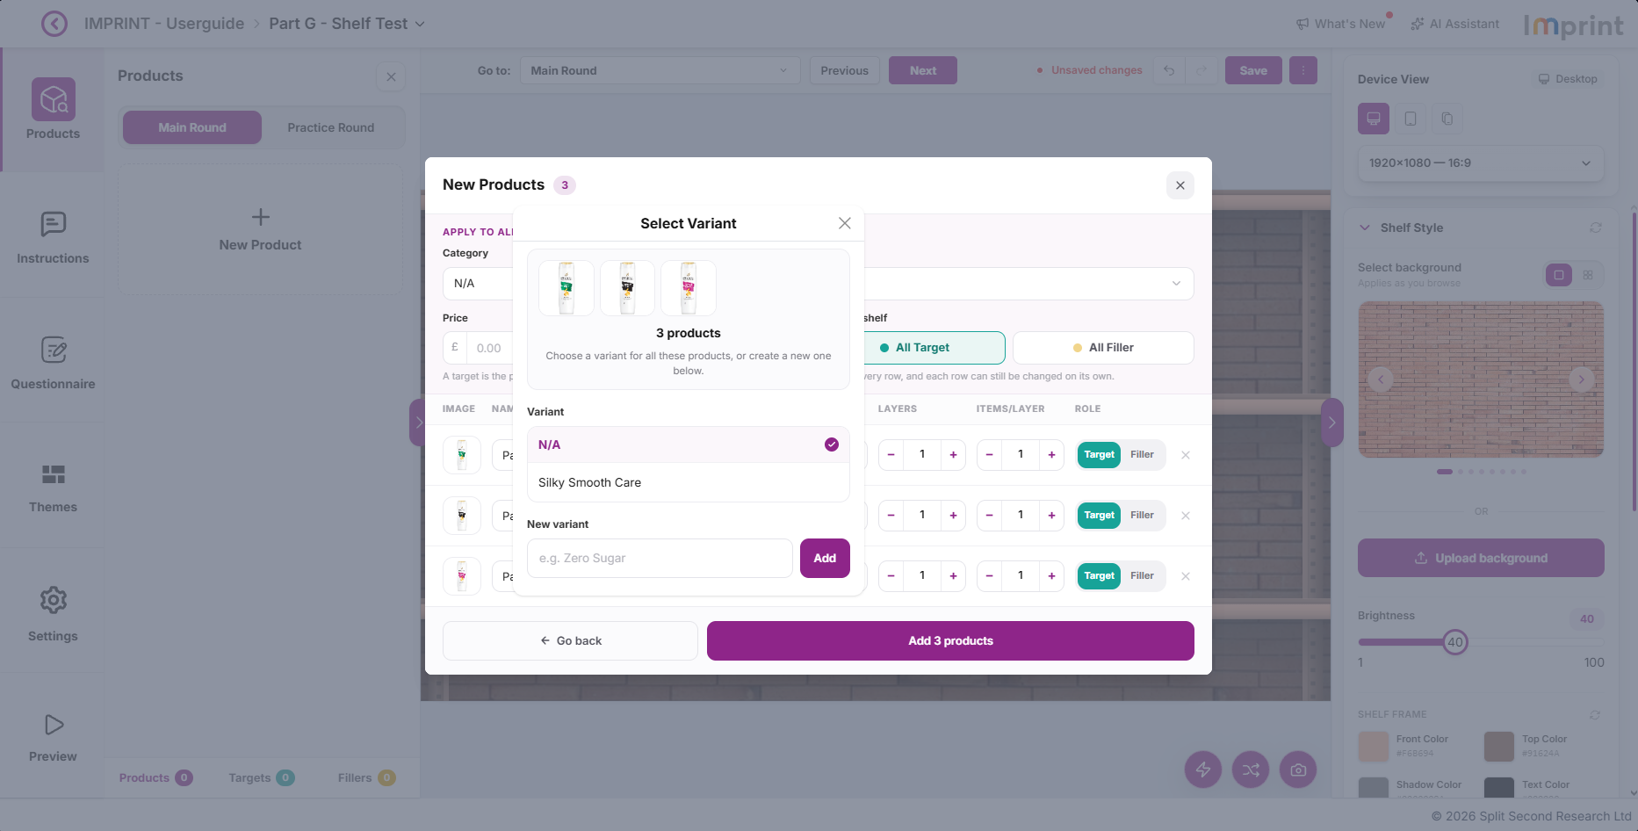
How do I Add a New Variant?
Table of Contents
In the New Products pop-up modal, click the Variant dropdown menu.
Click + Add Variant at the bottom of the dropdown menu to add a new variant.
The Select Variant pop-up modal will appear. Enter the New Variant you want to add.
Click Add to add the new category.
The New Variant will appear below N/A. Repeat Steps 3 to 4 to add additional variants.
1
2
3
4
5
5

Slide 51

How do I Select a Variant?
Table of Contents
In the New Products pop-up modal, click the Variant dropdown menu.
1
1

Slide 52
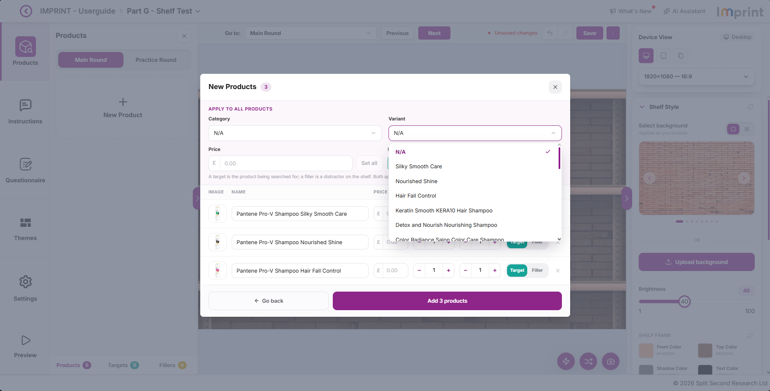
How do I Select a Variant?
Table of Contents
In the New Products pop-up modal, click the Variant dropdown menu.
Select the Variant you want to assign to your products.
1
2
2

Slide 53

How do I Select a Variant?
Table of Contents
In the New Products pop-up modal, click the Variant dropdown menu.
Select the Variant you want to assign to your products.
The selected Variant will now be applied to all products below.
1
2
3
3

Slide 54

How do I Edit a Variant?
Table of Contents
1
Click the Variant field.
1

Slide 55
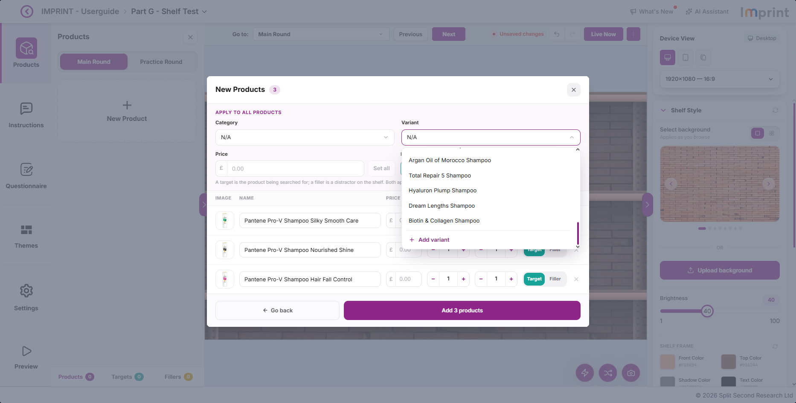
How do I Edit a Variant?
Table of Contents
1
Click the Variant field.
The Variant dropdown menu will appear. Scroll down and click + Add variant.
2
2

Slide 56

How do I Edit a Variant?
Table of Contents
1
Click the Variant field.
The Variant dropdown menu will appear. Scroll down and click + Add variant.
The Select Variant pop-up modal will appear. Hover over the variant you want to edit.
2
3
3

Slide 57

How do I Edit a Variant?
Table of Contents
1
Click the Variant field.
The Variant dropdown menu will appear. Scroll down and click + Add variant.
The Select Variant pop-up modal will appear. Hover over the variant you want to edit.
Two options will appear: Edit and Delete. Click the Edit icon.
2
3
4
4

Slide 58

How do I Edit a Variant?
Table of Contents
1
Click the Variant field.
The Variant dropdown menu will appear. Scroll down and click + Add variant.
The Select Variant pop-up modal will appear. Hover over the variant you want to edit.
Two options will appear: Edit and Delete. Click the Edit icon.
The variant will become editable. Enter the updated Variant.
2
3
4
5
5

Slide 59

How do I Edit a Variant?
Table of Contents
1
Click the Variant field.
The Variant dropdown menu will appear. Scroll down and click + Add variant.
The Select Variant pop-up modal will appear. Hover over the variant you want to edit.
Two options will appear: Edit and Delete. Click the Edit icon.
The variant will become editable. Enter the updated Variant.
Click the Check icon to save your changes. The variant will be updated.
2
3
4
5
6
6

Slide 60

How do I Delete / Remove a Variant?
Table of Contents
1
Click the Variant field.
1

Slide 61

How do I Delete / Remove a Variant?
Table of Contents
1
Click the Variant field.
The Variant dropdown menu will appear. Scroll down and click + Add variant.
2
2

Slide 62

How do I Delete / Remove a Variant?
Table of Contents
1
Click the Variant field.
The Variant dropdown menu will appear. Scroll down and click + Add variant.
The Select Variant pop-up modal will appear. Hover over the variant you want to delete.
2
3
3

Slide 63

How do I Delete / Remove a Variant?
Table of Contents
1
Click the Variant field.
The Variant dropdown menu will appear. Scroll down and click + Add variant.
The Select Variant pop-up modal will appear. Hover over the variant you want to delete.
Two options will appear: Edit and Delete. Click the Delete icon.
2
3
4
4

Slide 64
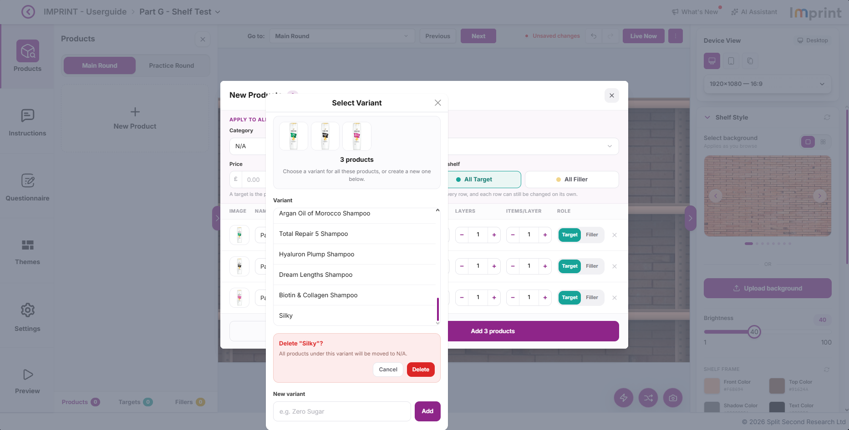
How do I Delete / Remove a Variant?
Table of Contents
1
Click the Variant field.
The Variant dropdown menu will appear. Scroll down and click + Add variant.
The Select Variant pop-up modal will appear. Hover over the variant you want to delete.
Two options will appear: Edit and Delete. Click the Delete icon.
A confirmation message will appear. Click Delete to delete / remove the variant.
2
3
4
5
5

